Slide 1
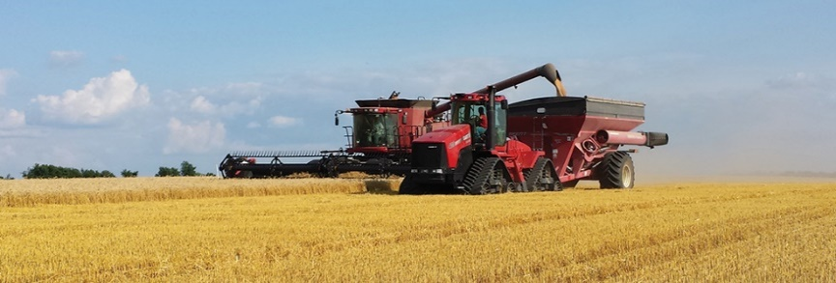
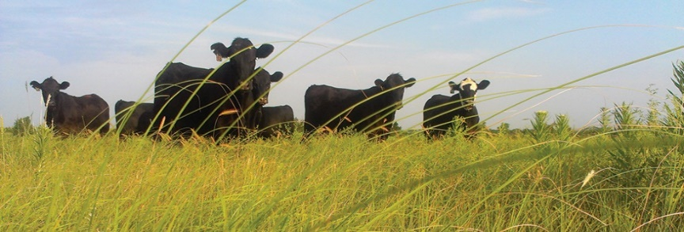
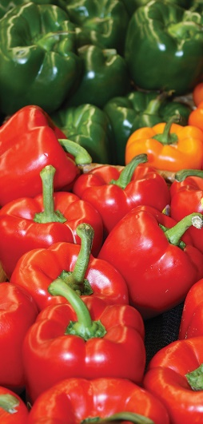
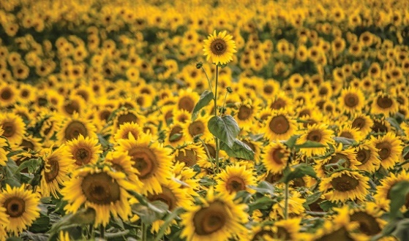
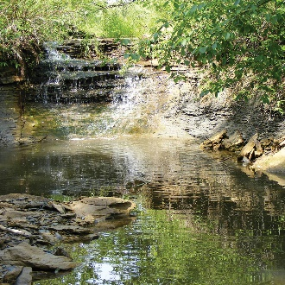
THE KANSAS
DEPARTMENT OF AGRICULTURE
KDA Update
4th Annual Kansas Hemp Conference
February 22, 2022
Virtual
SERVING
THE STATE’S
LARGEST INDUSTRY…
AGRICULTURE

Slide 2
How is hemp regulated in Kansas?
Table 1: Status of State, Tribe, and Territory hemp production plans updated 01/03/2022
Hemp has been legally grown in Kansas since February 8, 2019, after the passage of the Alternative Crop Research Act. The state operated under a pilot or research program for two seasons as permitted by the 2014 Farm Bill.
LABELS | COUNT
STATE | 50
Approved Plan | 45
USDA Hemp Producer License | 5
HI, MS, NH, NC and WI
TERRITORY | 2
Approved Plan | 2
TRIBE | 54
Approved Plan | 45
Prairie Band Potawatomi Nation Iowa Tribe of Kansas and Nebraska
Under Review | 5
USDA Hemp Producer License | 4
Grand Total | 106
Since January 2021, Kansas has been operating under a U.S. Department of Agriculture approved plan, as permitted by the Commercial Industrial Hemp Act and 2018 Farm Bill. Kansas will be entering its second growing season under this plan in 2022.
ams.usda.gov

Slide 3
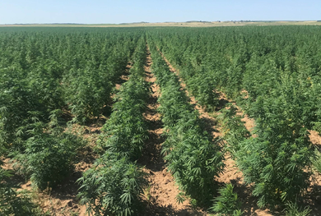
How is hemp regulated in Kansas?
Hemp Producers (Growers)
The Kansas Department of Agriculture only licenses hemp producers (growers)
Must license annually by the March 15 deadline
K.A.R. 4-34-1 and K.A.R. 4-34-22 through 4-34-30 only apply to the commercial production of industrial hemp.
agriculture.ks.gov/industrialhemp
Field production of hemp for biomass material using a tobacco model in Kiowa Co., KS

Slide 4
Permanent Rule and Regulation Adoption
After publication of USDA’s final rule on hemp production on January 19, 2021, the industrial hemp advisory board met, on March 19, 2021, to provide comments and recommendations for the revision of administrative rules and regulations which would expand operational allowances for hemp producers.
These operational allowances included: extending a harvest window from 15 days to 30 days from a sampling date, “hot” hemp being eligible for remediation and changes to the negligent violation threshold.
These regulations were adopted temporarily on August 25, 2021, and subsequently on a permanent basis on December 2, 2021; the permanent regulations were effective December 17, 2021. No substantial program changes occurred due to the adoption of the permanent regulations as they were already temporarily adopted.

Slide 5
Permanent Rule and Regulation Adoption
K.A.R. 4-34-24. Sampling, testing and harvest requirements.
KDA permanently amended K.A.R. 4-34-24, the regulation governing sampling, testing, and harvest requirements, that extends the timeframe within which licensees must complete harvest after samples of hemp are collected.
The amendment requires harvest to be completed within 30 days of sampling rather than 15 days and is in accordance with the corresponding provision of the USDA final rule on commercial hemp production, CFR §990.3(i), which states, “Samples from cannabis plants must be collected within 30 days prior to the anticipated harvest, for total delta-9 tetrahydrocannabinol concentration level testing.”

Slide 6
Permanent Rule and Regulation Adoption
K.A.R. 4-34-25. Remediation; effective disposal; violations.
KDA permanently amended K.A.R. 4-34-25, the regulation that governs effective disposal of hemp, to allow hemp that contains a delta-9 tetrahydrocannabinol (“THC”) concentration greater than 0.3 percent on a dry-weight basis to be remediated into a lawful product, rather than requiring all such hemp to be effectively disposed of.
The amendment allows plants produced as hemp to enter commerce if remediated to have a THC concentration of 0.3 percent or less on a dry-weight basis within 60 days of the issuance of a failing report of analysis.
The amendments to K.A.R. 4-34-25 also set out more detailed timelines and requirements for the remediation process and post-remediation handling, transportation, sampling and testing.

Slide 7
Permanent Rule and Regulation Adoption
K.A.R. 4-34-29. Negligent violations; corrective action plans
KDA permanently amended K.A.R. 4-34-29, the regulation that governs negligent violations of the Commercial Industrial Hemp Act, to provide that the THC threshold at which hemp will be considered to have been produced negligently is 1.0 percent, rather than the 0.5 percent provided for in the interim final rule.
This is in accordance with CFR §990.29(3) which states that “hemp producers do not commit a negligent violation…if they make reasonable efforts to grow hemp and the cannabis does not have a total THC concentration of more than 1.0 percent on a dry weight basis.”

Slide 8
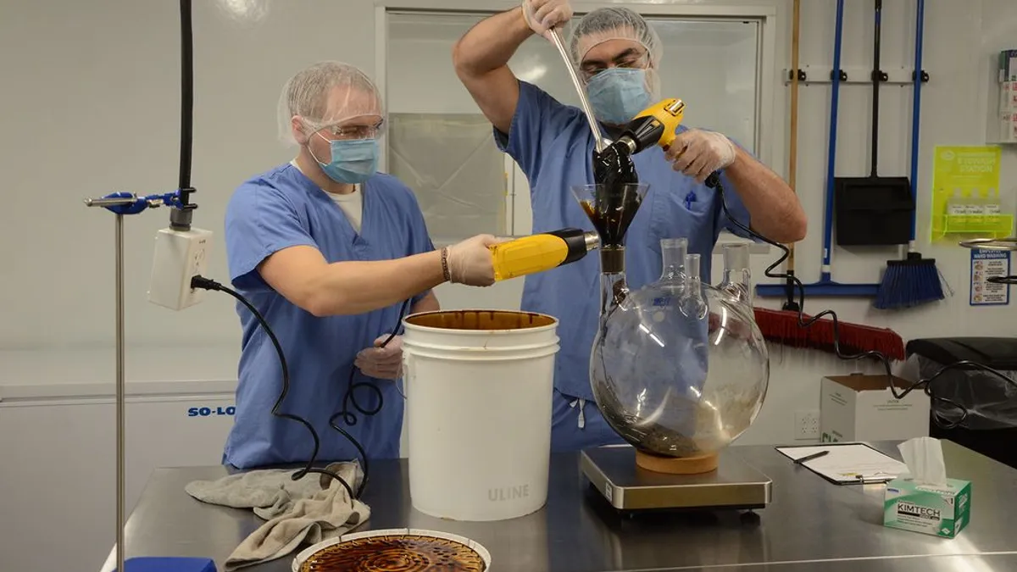
How is hemp regulated in Kansas?
Hemp Processor Registry
The Office of the State Fire Marshal registers hemp processors on an annual basis.
K.A.R. 22-26-1 through K.A.R. 22-26-16 only apply to processing of industrial hemp.
firemarshal.ks.gov/334
Riley, 2021

Slide 9
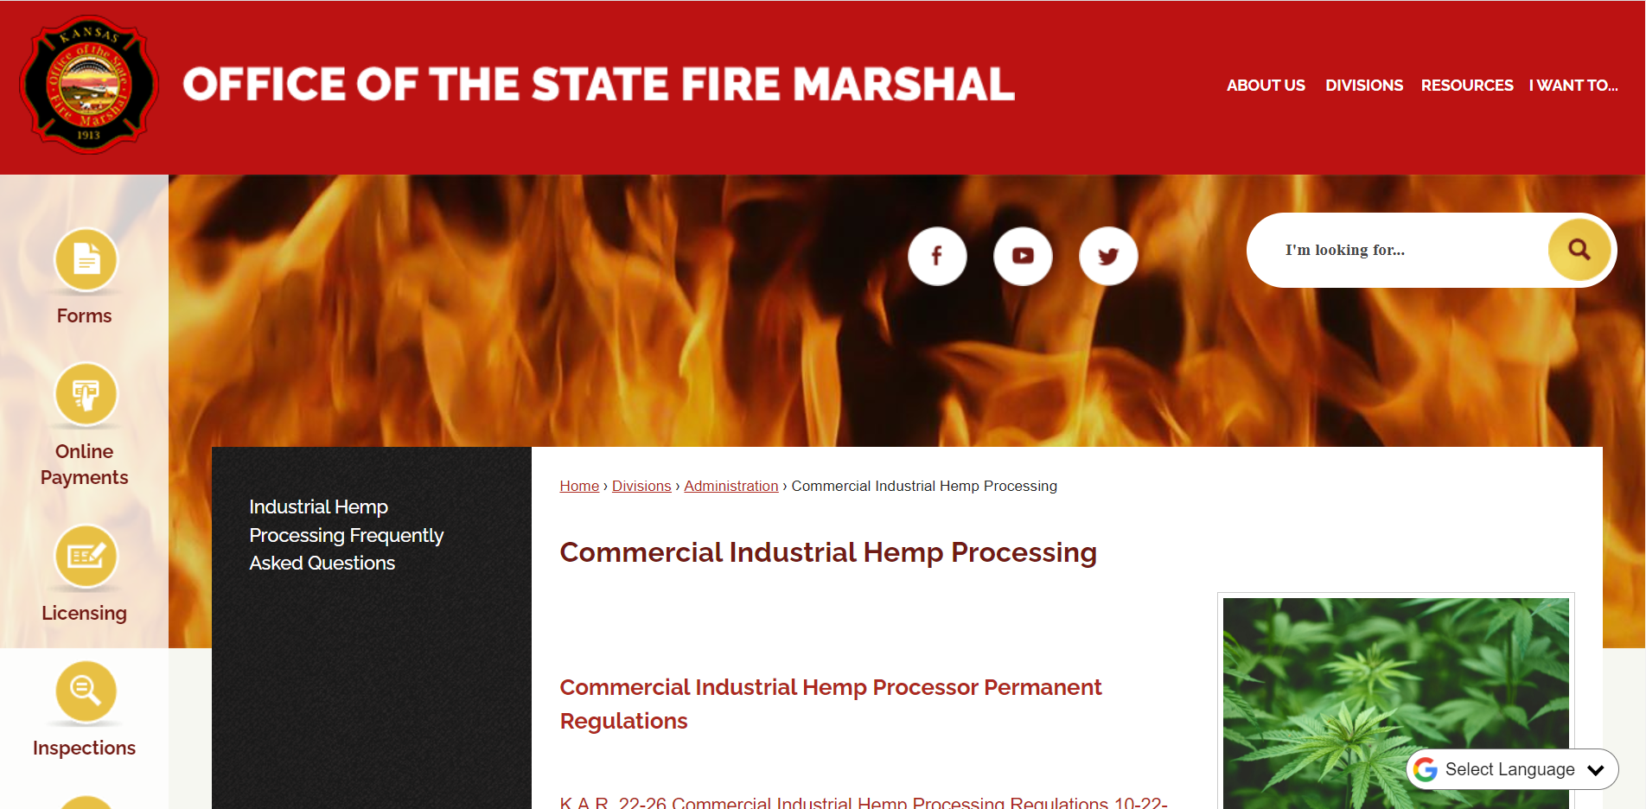
Office of the State Fire Marshal – Hemp Processor Resources
Commercial Industrial Hemp Processing Page: firemarshal.ks.gov/334
Office of the State Fire Marshal Commercial Industrial Hemp Processing
800 SW Jackson, Ste. 104
Topeka, KS 66612
KSFM_HEMP@ks.gov
785-296-3401

Slide 10
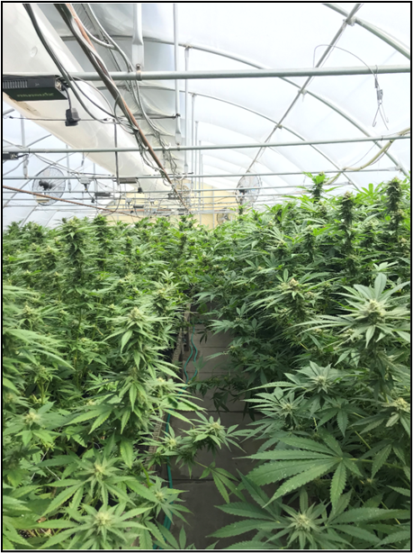
Industrial Hemp Acreages- Licensed and Planted
Table 3: Industrial hemp acreages from 2019 to 2021
Activity | 2019 |  | 2020 |  | 2021
 | Acreage | Counties | Acreage | Counties | Acreage | Counties
Licensed | 5,800 | 70 | 9,925 | 71 | 1,630 | 46
Planted | 2,782 | 59 | 3,968 | 58 | 501^{z} | 35
Harvested | 1,831 | 52 | 761 | 45 | 260 | 24
^{z}2021 planted acres revised from hemp summary for virtual outreach event for Kansas elected officials.
2019 and 2020 acres reported as planted were predominately (approximately 90%) for floral/CBD production. In 2021, 26% of acres planted were for floral/CBD production where Grain/Fiber, Seed/Grain and Fiber contributed to approximately 19%, 23%, and 31% of the planted acres, respectively.
Greenhouse production of hemp for floral material in Reno Co., KS

Slide 11
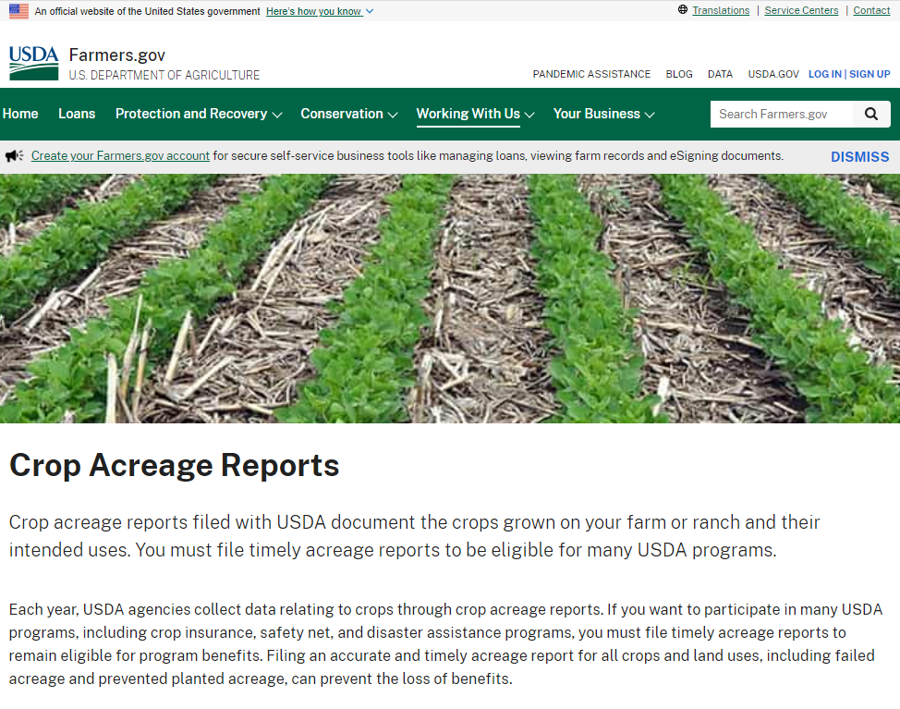
Industrial Hemp Acreages - Licensed and Planted
Licensed hemp producers who plant industrial hemp are not only required to report each planting of industrial hemp to KDA, but they must file Crop Acreage Report with United States Department of Agriculture – Farm Service Agency (USDA – FSA).
USDA – FSA has resources for filing Crop Acreage Reports, including but not limited to: locating your nearest service center, deadlines, how the reporting works, frequency of reporting, and applicable information if you are a beginning farmer and have not established yourself with their offices.
farmers.gov/crop-acreage-reports

Slide 12
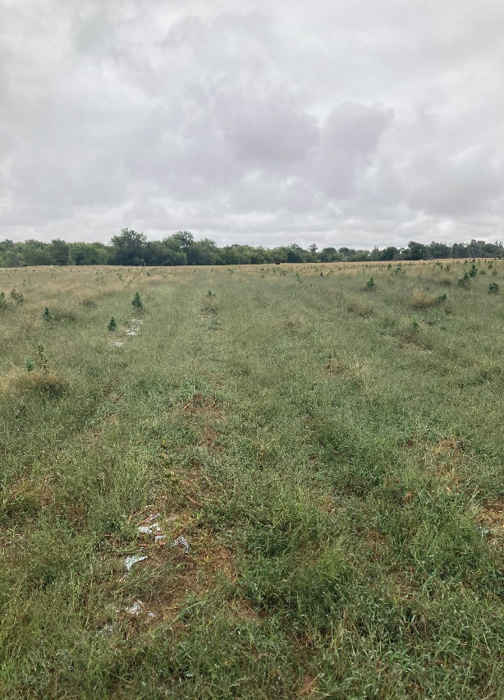
Industrial Hemp Acreages — Harvested
Table 3: Industrial hemp acreages from 2019 to 2021
Activity | 2019 |  | 2020 |  | 2021
 | Acreage | Counties | Acreage | Counties | Acreage | Counties
Licensed | 5,800 | 70 | 9,925 | 71 | 1,630 | 46
Planted | 2,782 | 59 | 3,968 | 58 | 501^{z} | 35
Harvested | 1,831 | 52 | 761 | 45 | 260 | 24
54 (2019), 34 (2020), and 0.06 (2021) acres tested noncompliant (> 0.3% THC). KDA adopted a 30-day sampling window in the 2021 season.
Roughly 890 (2019), 3,149 (2020), 241 (2021) planted acres were nonyielding or failed to produce a crop. In 2021, poor germination/emergence (56%) and adverse weather (37%) contributed to 93% of reported acreage lost. Other contributing factors of loss related to pesticide damage (2%), pests (2%), voluntary disposal (2%), weed pressure (> 1%), etc.
Field production of hemp for biomass material using a plasticulure model in Harper Co., KS

Slide 13
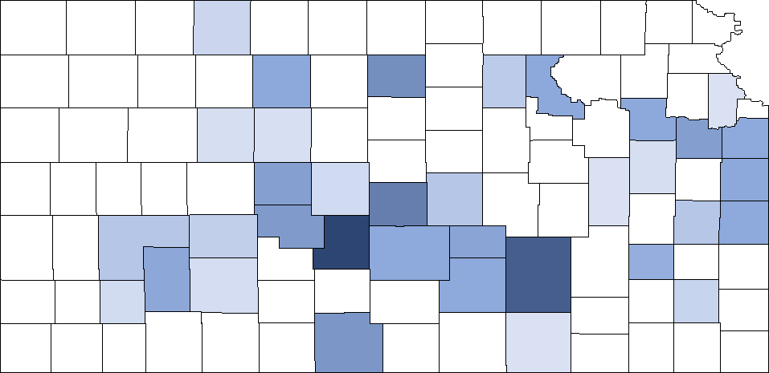
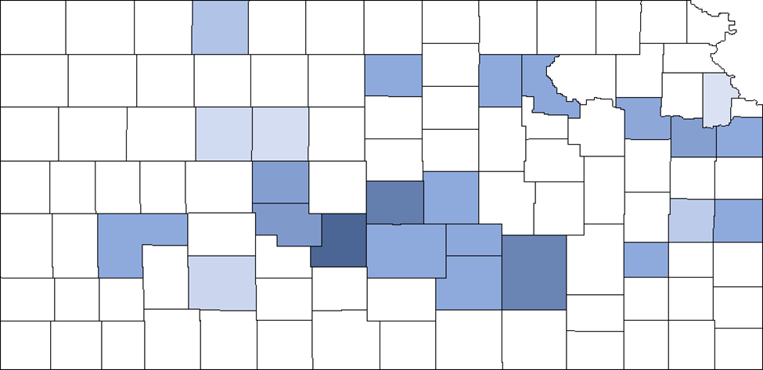
Industrial Hemp Acreages
Figure 1: 2021 distribution in acres of hemp reported as planted (left) and harvested (right)
Planted
Harvested
0.001 acres
50th Percentile
165 acres
57 (70%) of the 81 licenses conducted planting activity where of those 57 licenses 38 (66%) conducted a harvest

Slide 14
2021 NASS Hemp Survey
Kansas Hemp Acreage
Industrial hemp grown in open areas in Kansas totaled 540 acres, according to the USDA’s National Agricultural Statistics Service (NASS). Industrial hemp harvested in open areas totaled 400 acres. This is the first time USDA’s NASS has published estimates on industrial hemp.
Estimates inclusive of hemp planted in tribal land where KDA does not regulate production in tribal lands. Planted acres most likely exceed estimates as not all acreage reported to USDA FSA.
Additional information can be found in the National report at: https://usda.library.cornell.edu/concern/publications/gf06h2430?locale=en

Slide 15
Expansion and Contraction of Hemp Cultivation Nationwide from 2015 to 2021
Group 1: Since 2014
Group 2: Since 2017
Group 3: Since 2019
Group 4: Since 2020
FSA Acres
FSA Acres
Production Year
Production Year
S1084 Virtual Meeting. Dr. Tyler Mark. University of Kentucky Agriculture Economics. Presented 02/17/2022

Slide 16
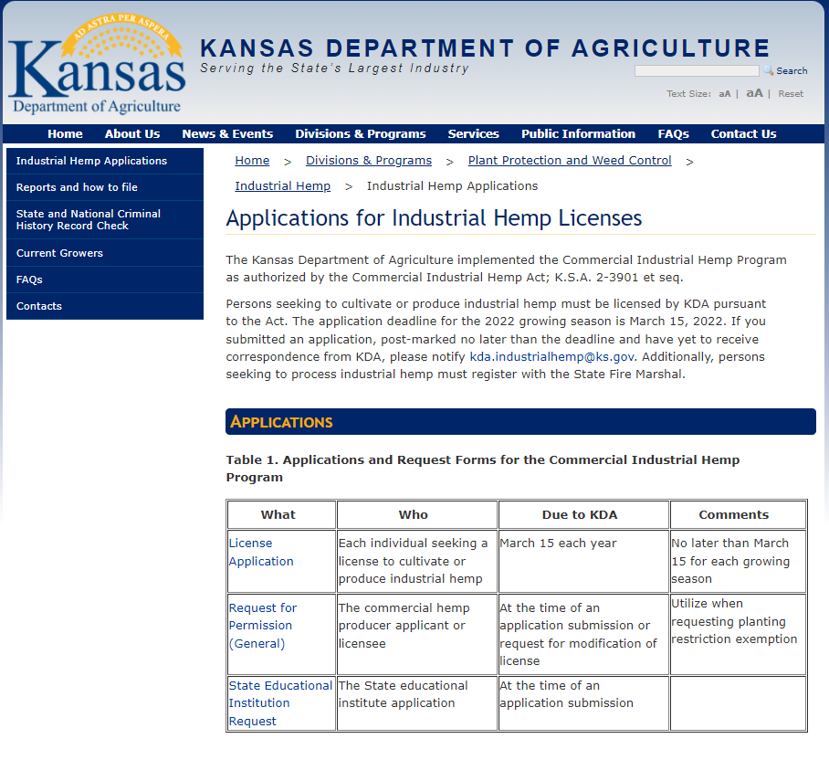
Industrial Hemp Licensing 2022
All 2021 hemp producer licenses expired December 31, 2021, except those of state educational institution participants who hold a multi-year license. As of February 17, 2022, KDA has issued 24 licenses and three applications are under review.
The application deadline for 2022 licensing is Tuesday, March 15, 2022; applications must be post-marked no later than the deadline.
Applications for Industrial Hemp Licenses may be found on the KDA’s webpage.
agriculture.ks.gov/industrialhemp

Slide 17
2022 Production Outlook in Kansas
Most likely see a decrease in licensed acreage. Majority of that acreage will be dedicated to grain and fiber where floral production will most likely fall in acreage.
In 2021, KDA received approximately 50% of all applications after the first week in March.
License Status as of 2/17/2022 | Count | Acreage
Complete No Background | 1 | 24.25
Conditional Approval | 2 | 1.22
Active- Licensed | 24 | 364.24
Total | 27 | 389.71

Slide 18
Hemp Budget Models- University of Kentucky
Hemp & Enterprise Budget Model hemp.ca.uky.edu/grower%20resources
Hemp Grain
Hemp Fiber
CBD Row Crop Grain Harvested
CBD Row Crop NO Grain
CBD Tobacco Model/Bare Ground Model
CBD Plasticulture Model
S1084 Virtual Meeting. Dr. Tyler Mark. University of Kentucky Agriculture Economics. Presented 02/17/2022
Notes:
Current observations of the industry reveals that production methods are highly varied but generally fit into one of six production methods represented in these budgets. Yields are also highly variably between and within each production model. Unlike a traditional crop enterprise budgets, where using the default production costs estimates may be a reasonable approximation of a given producers actual costs, the lacking publicly available empirical research centered around hemp production requires potential producers to adjust each line to fit the specifics of their operation. Cost and revenue estimates provided in these budgets should be critically evaluated and adjusted for each producer’s scenario.

Slide 19
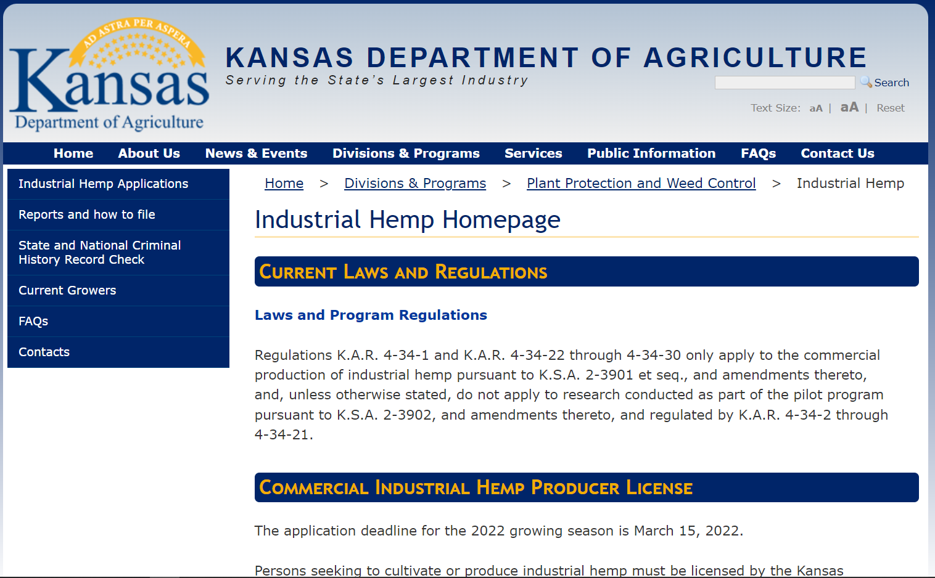
KDA Hemp Producer Contacts and Resources
Industrial Hemp Homepage: agriculture.ks.gov/industrialhemp
Kansas Department of Agriculture
Commercial Industrial Hemp Program
1320 Research Park Drive
Manhattan, KS 66502
kda.industrialhemp@ks.gov
785-654-6789

Slide 20
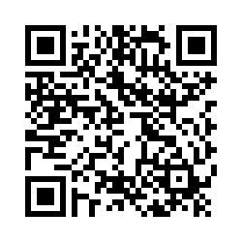
THANK YOU
Dana Ladner
Compliance, Education and Agency Support Program Manager
Agriculture Advocacy, Marketing and Outreach
Kansas Department of Agriculture
1320 Research Park Drive
Manhattan, KS 66502
dana.ladner@ks.gov
SERVING
THE STATE’S
LARGEST INDUSTRY…
AGRICULTURE
2022 Ag Workforce Assessment Survey
https://agriculture.ks.gov/divisions-programs/agricultural-marketing-advocacy-and-outreach-team/workforce-development

